Slide 1
Model View Controller
MVC Web Software Architecture
Lecture 14

Slide 2
Introduction
Model View Controller or MVC as it is popularly called, is a software design pattern for developing web applications.
Model–view–controller (MVC) is a software architecture pattern which separates the representation of information from the user's interaction with it .

Slide 3
Parts of MVC
A Model View Controller pattern is made up of the following three parts:
Model
View
Controller

Slide 4
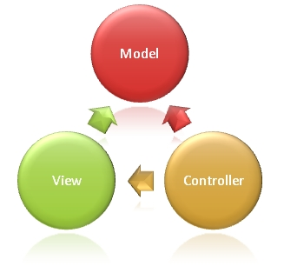
The MVC model defines web
applications with 3 logic layers:
The business layer (Model logic)
The display layer (View logic)
The input control (Controller logic)

Slide 5
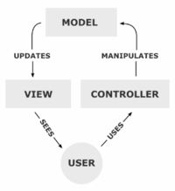

Slide 6
Model
The model is responsible for managing the data of the application.
It responds to the request from the view and it also responds to instructions from the controller to update itself
It is the lowest level of the pattern which is responsible for maintaining data.
The Model represents the application core (for instance a list of database records).
It is also called the domain layer

Slide 7
View
The View displays the data (the database records).
A view requests information from the model, that it needs to generate an output representation.
MVC is often seen in web applications, where the view is the HTML page.

Slide 8
Controller
The Controller is the part of the application that handles user interaction.
Typically controllers read data from a view, control user input, and send input data to the model.
It handles the input, typically user actions and may invoke changes on the model and view.

Slide 9
Workflow in MVC - Example
Though MVC comes in diﬀerent ﬂavours, the control ﬂow generally works as follows:
1. The user interacts with the user interface in some way (e.g., user presses a button)
2. A controller handles the input event from the user interface, often via a registered handler or callback.
3. The controller accesses the model, possibly updating it in a way appropriate to the user’s
action (e.g., controller updates user’s shopping cart).

Slide 10
4. A view uses the model to generate an appropriate user interface (e.g., view produces a screen listing the shopping cart contents).
The view gets its own data from the model. The model has no direct knowledge of the view.

Slide 11
Dependence hierarchy
There is usually a kind of hierarchy in the MVC pattern.
The Model knows only about itself.
That is, the source code of the Model has no references to either the View or Controller.

Slide 12
The View however, knows about the Model. It will poll the Model about the state, to know what to display.
That way, the View can display something that is based on what the Model has done.
But the View knows nothing about the Controller.
The Controller knows about both the Model and the View.

Slide 13
Why dependence hierarchy is used?
The reason to keep it this way is to minimize dependencies.
No matter how the View class is modified, the Model will still work.
Even if the system is moved from a desktop operating system to a smart phone, the Model can be moved with no changes.
But the View probably needs to be updated, as will the Controller.

Slide 14
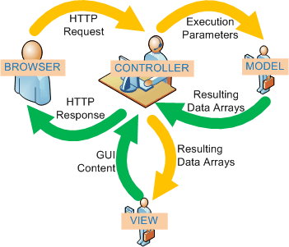
Working of MVC in web application

Slide 15
Normal Web Page vs. MVC
The MVC programming model is a lighter alternative to traditional Web Page/Forms.
It is a lightweight, highly testable framework, integrated with all existing features, such as Security, and Authentication.

Slide 16
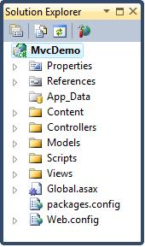
MVC Folders
Application information
Properties
References
Application folders
App_Data Folder
Content Folder
Controllers Folder
Models Folder
Scripts Folder
Views Folder
Configuration files
Global.asax
packages.config
Web.config

Slide 17
Advantages
Clear separation between presentation logic and business logic.
Each object in mvc have distinct responsibilities.
parallel development
easy to maintain and future enhancements
All objects and classes are independent of each other.

Slide 18
Disadvantages
Increased complexity
Inefficiency of data access in view
Difficulty of using MVC with modern user interface too.
For parallel development there is a needed multiple programmers.
Knowledge on multiple technologies is required.

